Slide 1

Breaking Down Complex Systems with RabbitMQ
Erie Web Development Group
July 23, 2014
Eric Kepes

Slide 2
Breaking Down Complex Systems with RabbitMQ
TBD

Slide 3
What is RabbitMQ?
A Message Broker
Cross-platform
Implements AMQP standard
Open Source (MPL)
Built on Erlang

Slide 4
Why Messaging?
Allows a system to be broken into parts
Facilitates reliable background work
Enables scaling out
Provides a way to recover from/work around outages

Slide 5
Why Break Up?

Slide 6
Installing RabbitMQ
Install Erlang
http://www.erlang.org/download.html
Install RabbitMQ
http://www.rabbitmq.com/install-windows.html

Slide 7
Parts of RabbitMQ
Producers
Consumers
Queues
Exchanges

Slide 8
RabbitMQ – Admin Console
Open the RabbitMQ Prompt
Type: rabbitmq-plugins enable rabbitmq_management
Restart RabbitMQ
Navigate to: http://localhost:15672/
Default login: guest/guest

Slide 9
Background Worker Scenarios
Offload work
Same application, background thread
Different application/service (same or different machine)
Multiple instances of an application/service on multiple machines

Slide 10
Demo
Simple Background Worker

Slide 11
Demo
Scaling Out Background Worker

Slide 12
Pub/Sub
Publisher
Sends out messages about it’s activity (events)
Subscriber(s)
Receive messages and do work

Slide 13
Why Pub/Sub?
Different work that needs to be done when an event completes
Decoupling to allow flexibility
Refresh multiple clients

Slide 14
Demo
Pub/Sub – Fanout Exchange

Slide 15
Demo
Pub/Sub – Topic Exchange

Slide 16
Other Considerations

Slide 17
“Good” Practices
Have a message versioning strategy
Don’t use messaging/queues for RPC
Create a meaningful hierarchy for your topics
Ex: <company name>.<application name>.<concern>.<message purpose>

Slide 18
MassTransit

Slide 19
Domain Driven Design

Slide 20
Questions?

Slide 21
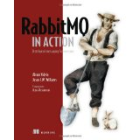
Further Reading
RabbitMQ in Action
Alvaro Videla
Jason Williams

Slide 22

Further Reading
Patterns of Enterprise Application Architecture
Martin Fowler

Slide 23
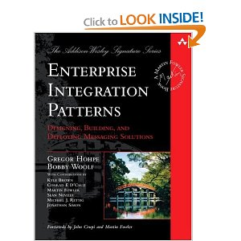
Further Reading
Enterprise Integration Patterns: Designing, Building, and Deploying Messaging Solutions
Gregor Hohpe
Bobby Woolf

Slide 24
For more details:
Domain Driven Design – Eric Evans
DDD Quickly (the Cliff Notes): http://www.infoq.com/minibooks/domain-driven-design-quickly

Slide 25
Resources
MassTransit
Docs: http://docs.masstransit-project.com
Google Groups: http://groups.google.com/group/masstransit-discuss/
Chris Patterson: http://blog.phatboyg.com/
Dru Sellers: http://codebetter.com/drusellers/
Messaging/Distributed Systems
Udi Dahan: http://www.udidahan.com/
Martin Fowler – Patterns in Enterprise Software: http://www.martinfowler.com/articles/enterprisePatterns.html

Slide 26
Thank You!
Github: https://github.com/ekepes
Twitter: @ekepes
Blog: http://erickepes.com
Email: eric@kepes.net
Demos and Slides:
https://github.com/ekepes/Presentations

